Slide 1
Constraints in ER Model
Rushali Patil

Slide 2
Constraints on Relationship Types
Relationship types usually have certain constraints that limit the possible combinations of entities that may participate in the corresponding relationship set
Determined from the Miniworld situation that the relationships represent
Example: if the company has a rule that each employee must work for exactly one department
There are two types of relationship constraints:
Cardinality Ratio
Participation

Slide 3
Cardinality Ratios for Binary Relationships
Cardinality Ratio for a binary relationship specifies the number of relationship instances that an entity can participate in
The cardinality constraints is expressed by drawing either a directed line (→), signifying “one,” or an undirected line (—), signifying “many,” between the relationship set and the entity set

Slide 4
Cardinality Ratios for Binary Relationships
One-to-One cardinality (1:1 )
Many-to-One cardinality (m:1)
Cardinality Ratio
One-to-Many cardinality (1:n)
Many-to-Many cardinality (m:n)

Slide 5
One-to-One Cardinality
An entity in set A can be associated with at most one entity in set B
An entity in set B can be associated with at most one entity in set A
R

Slide 6
Example
Has
Person
Adhar-Card

Slide 7
Many-to-One Cardinality
An entity in set A can be associated with at most one entity in set B
An entity in set B can be associated with any number (zero or more) of entities in set A
R

Slide 8
Example
Enrolled
Students
NPTEL DBMS Course

Slide 9
One-to-Many Cardinality
An entity in set A can be associated with any number (zero or more) of entities in set B
An entity in set B can be associated with at most one entity in set A
R

Slide 10
Example
Place
Customer
Orders
(Amazon)

Slide 11
Many-to-Many Cardinality
An entity in set A can be associated with any number (zero or more) of entities in set B
An entity in set B can be associated with any number (zero or more) of entities in set A
R

Slide 12
Example
borrow
Customer
loan

Slide 13
Participation Constraints
Participation Constraints
Total Participation
Partial Participation

Slide 14
Total Participation
It specifies that each entity in the entity set must compulsorily participate in at least one relationship instance in that relationship set
Also called as mandatory participation
Total participation is represented using a double line between the entity set and relationship set
E
R

Slide 15
Set Representation
Ram
Sham
Sita
R1
R2
R3
DBMS
TOC
CN
SEPM
ISEE

Slide 16
Example
Course
Student
Enrolled In

Slide 17
Partial Participation
It specifies that each entity in the entity set may or may not participate in the relationship instance in that relationship set
It is also called as optional participation
Partial participation is represented using a single line between the entity set and relationship set
R
E

Slide 18
Set Representation
Ram
Lina
Tina
Sham
Sita
R1
R2
R3
R4
Nature
Cultural
Spiritual

Slide 19
Example
Students
Counsel
Faculty

Slide 20
Roles
Entity sets of a relationship need not be distinct
Roles are indicated in E-R diagrams by labeling the lines that connect diamonds to rectangles
Role labels are optional, and are used to clarify semantics of the relationship

Slide 21
Example
Students
Learner
teaches
Presenter
Faculty

Slide 22
Weak Entity
Weak Entity set is an entity set that does not contain sufficient attributes to uniquely identify its entities.
In other words, a primary key does not exist for a weak entity set
It contains a partial key called as a discriminator
Discriminator can identify a group of entities from the entity set
Discriminator is represented by underlining with a dashed line
The combination of discriminator and primary key of the strong entity set makes it possible to uniquely identify all entities of the weak entity set

Slide 23
Note
A double rectangle is used for representing a weak entity set
A double diamond symbol is used for representing the relationship that exists between the strong and weak entity sets and this relationship is known as identifying relationship
A double line is used for representing the connection of the weak entity set with the relationship set
Total participation always exists in the identifying relationship

Slide 24
Example
Primary Key
Discriminator
E-ID and Dname together identify weak entity set Dependents.
E-ID
Ename
Dname
Age
Employee
Has
Dependents
Dept
Relationship

Slide 25
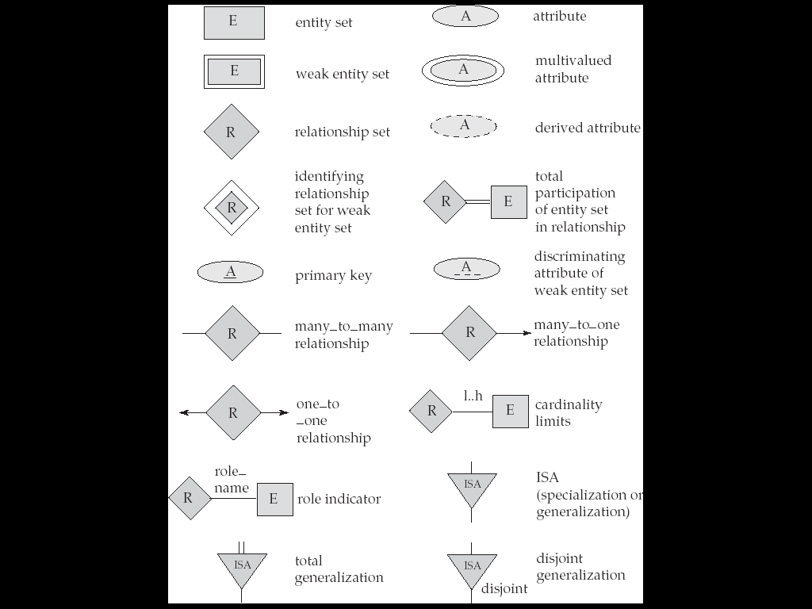
Symbols Used in E-R Notation

Slide 26
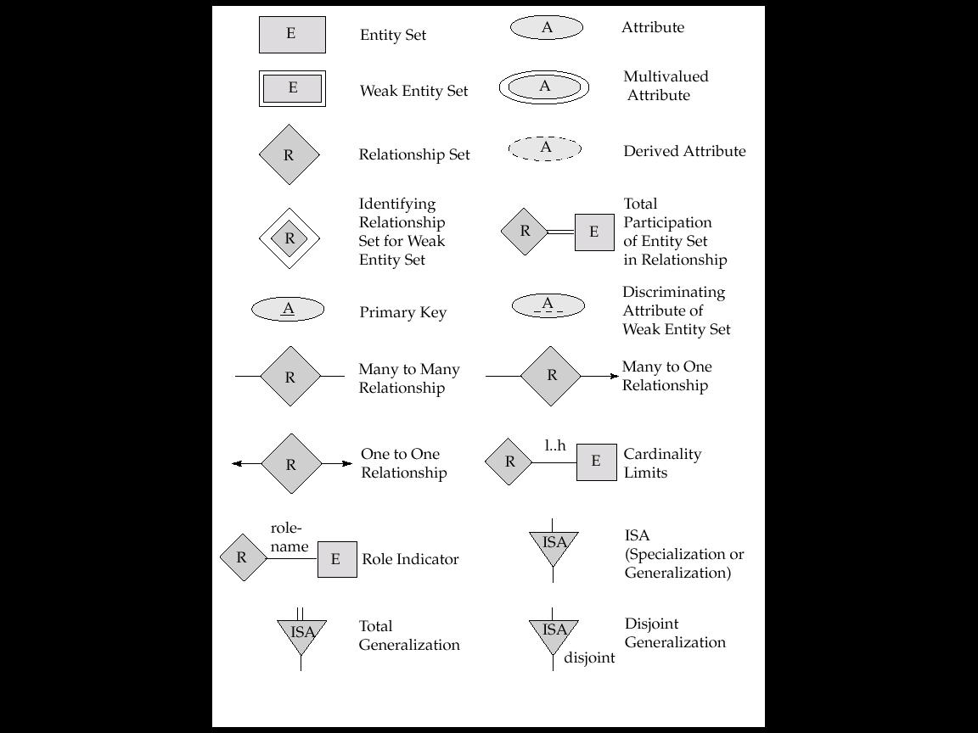
Symbols Used in E-R Notation

